Slide 1
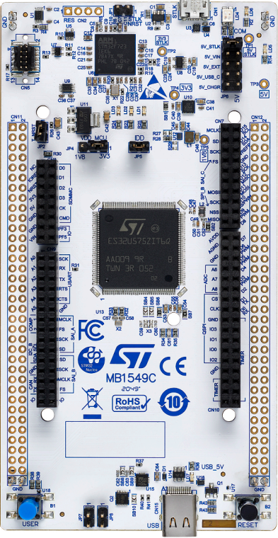
STM NUCLEO Board prep for microSWIFT v2 wave buoy
(NUCLEO-U575ZI-Q)
Alex de Klerk, Aug 2023

Slide 2
Follow ESD safe practices while handing electronic circuit board and components
Use an ESD safe work mat that is grounded
Wear grounding strap
Store board in factory anti-static bag

Slide 3
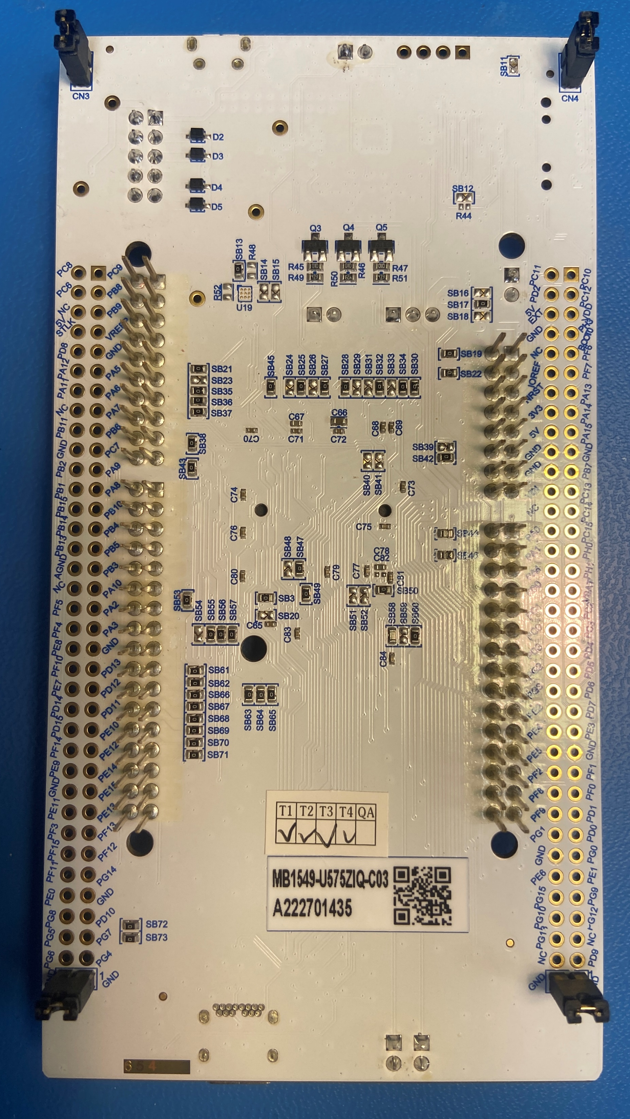
1) Flush cut header pins
Remove board from packaging
Use good flush cutters (Knipex or similar)
Trim header pins on bottom side of board flush with board (red boxes)
Be careful not to damage silk screen or traces

Slide 4
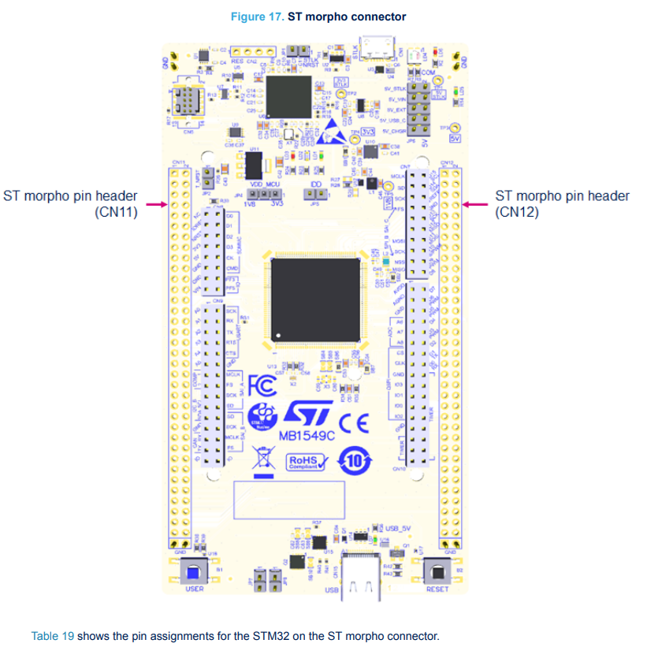
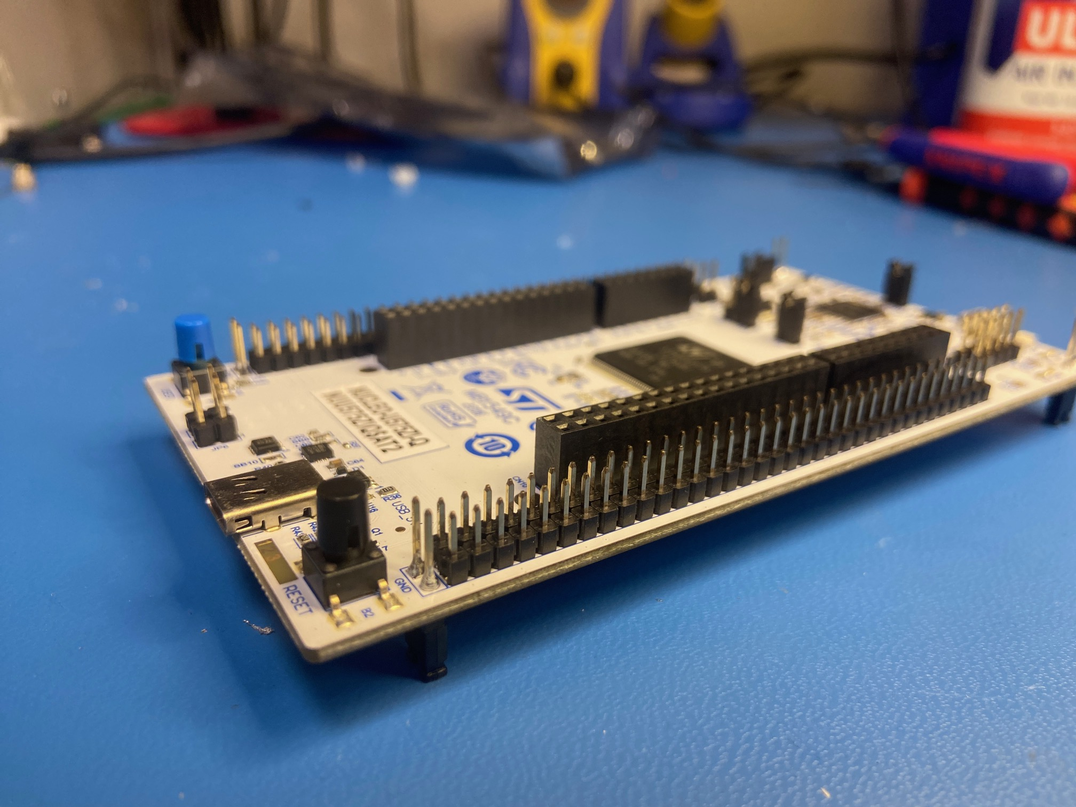
2) Solder male header pins
Use 2x35 male header pins, qty 2
Solder on top side of board in MORPHO locations (outer 4 rows) as shown below
Use flux and make sure flows between pad and header pin

Slide 5
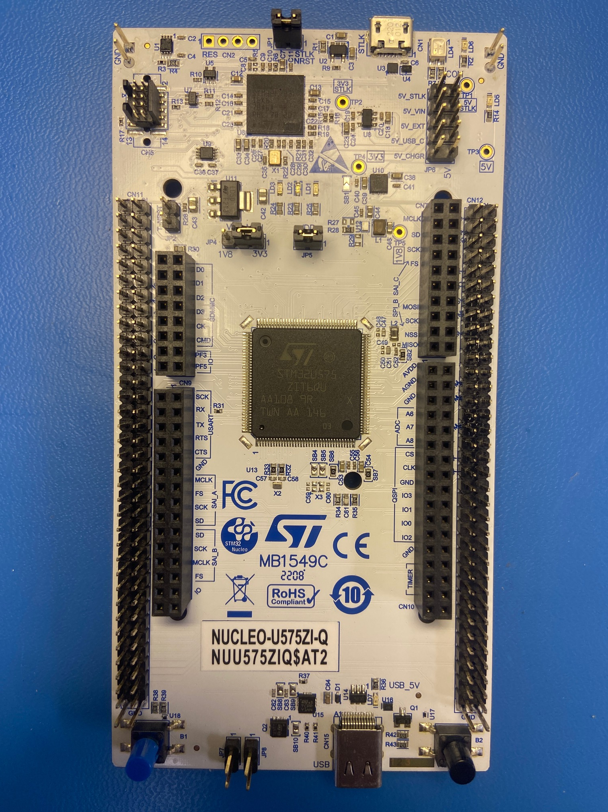
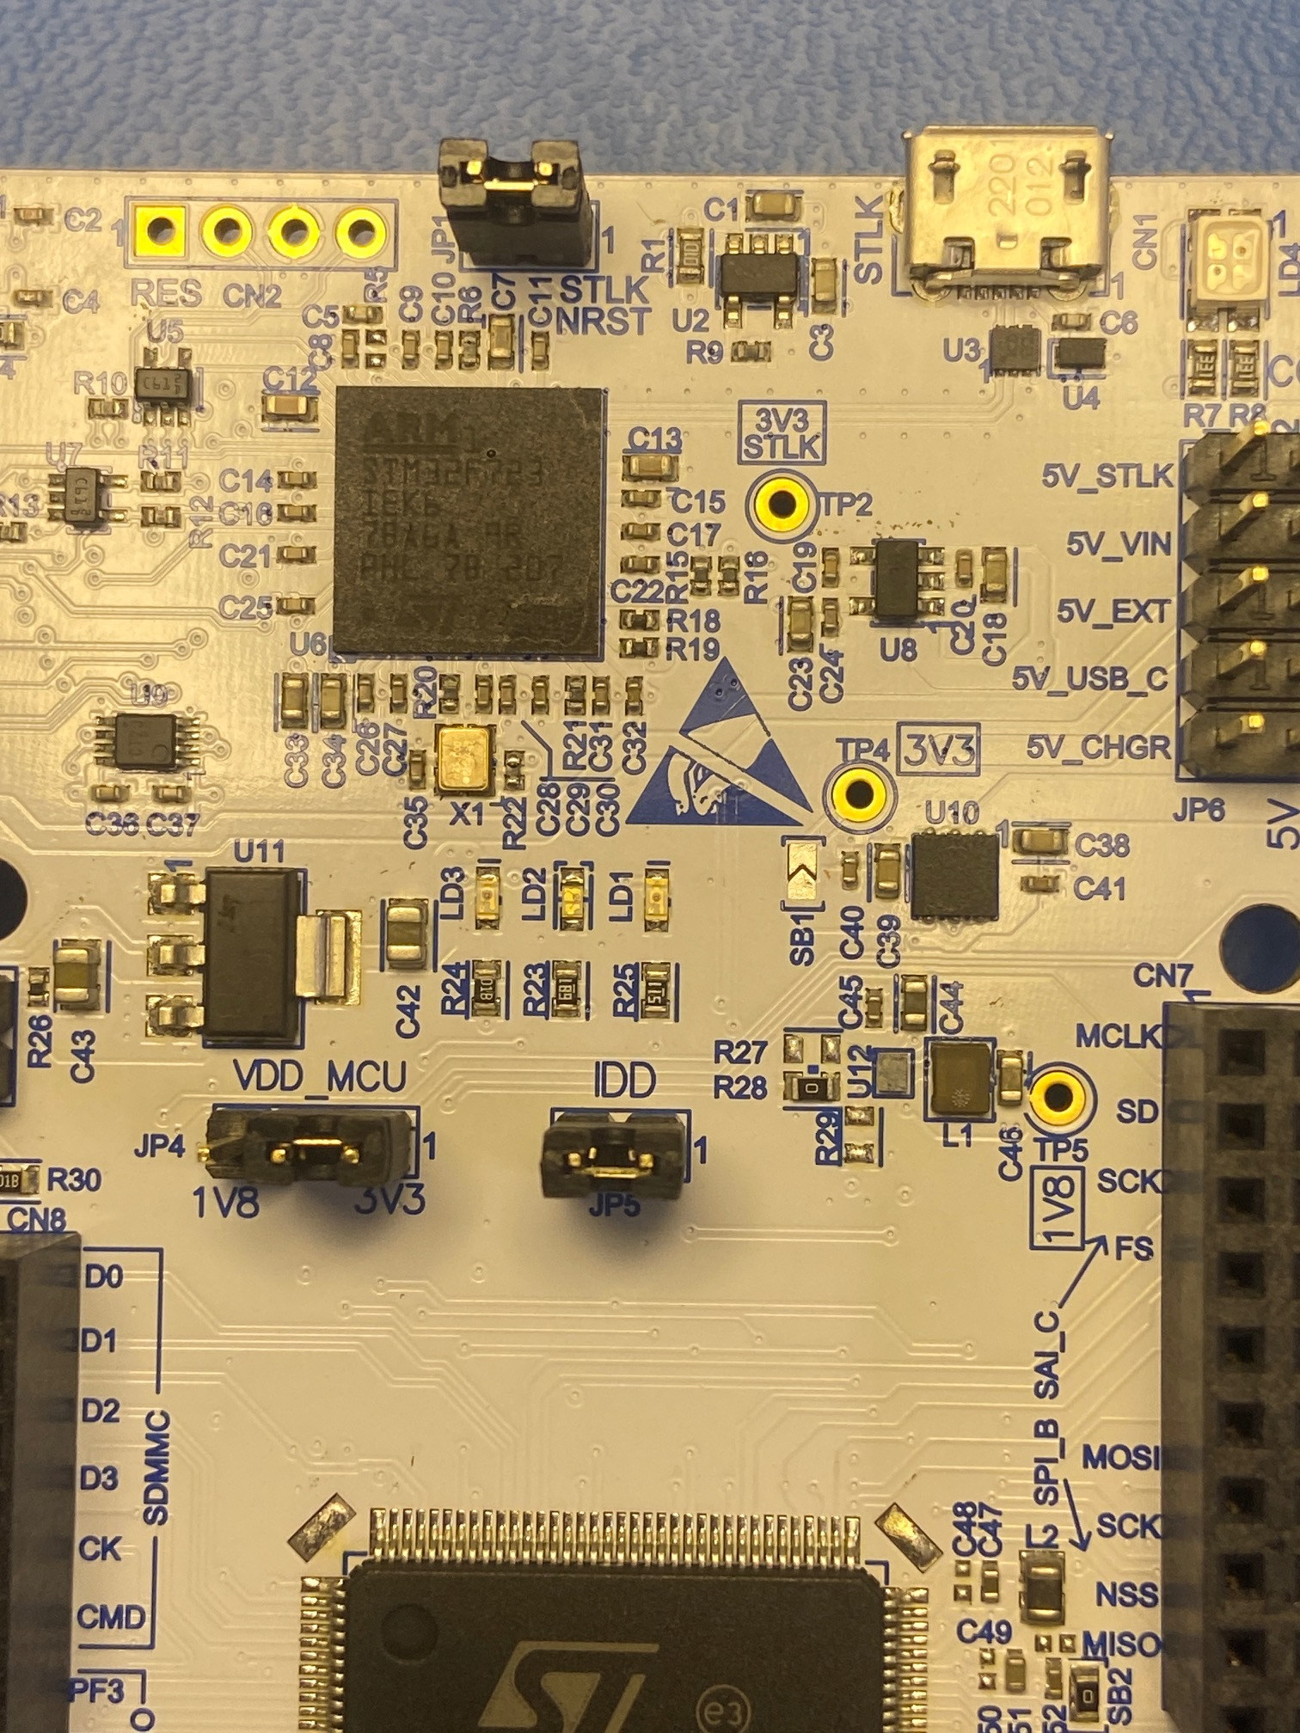
3) De-populate SB1
Remove 0 Ohm resistor from SB1 location
Use solder wick and flux to remove excess solder
SB1

Slide 6
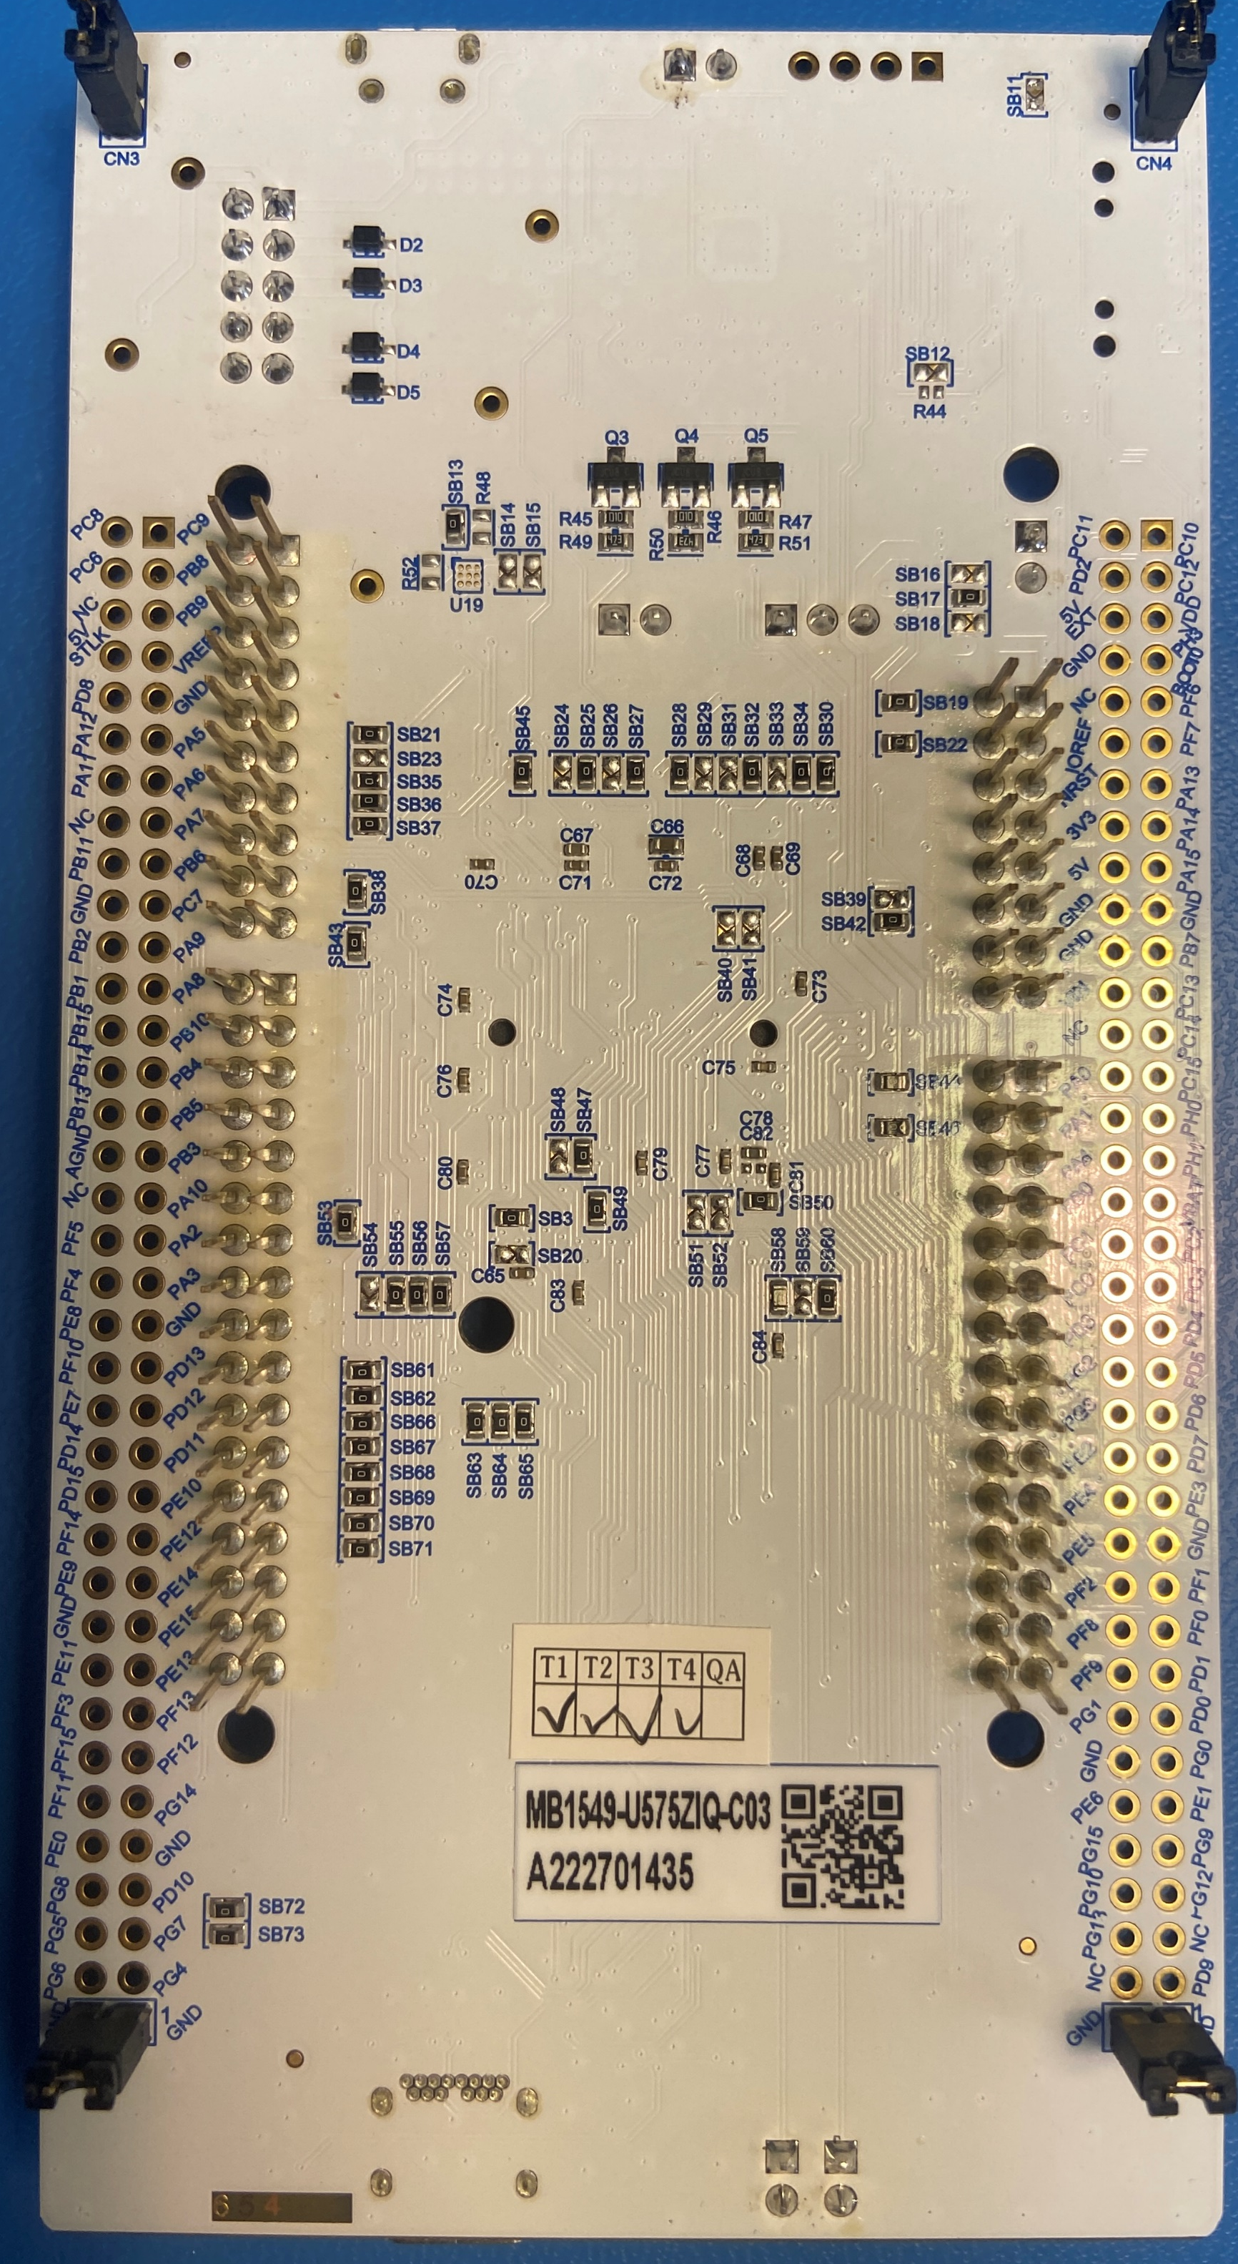
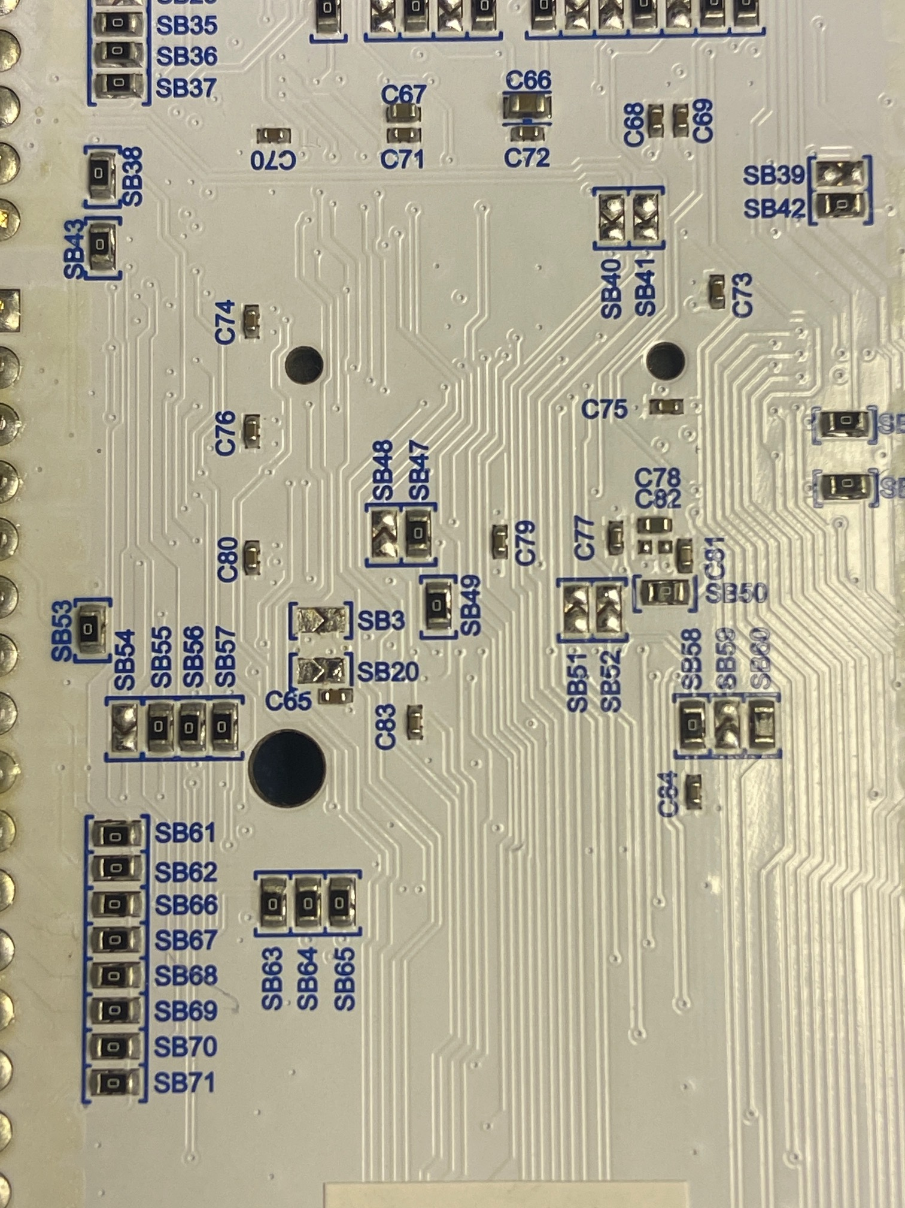
4) De-populate SB3
Remove 0 Ohm resistor from SB3 location (bottom side)
Use solder wick and flux to remove excess solder
SB3

Slide 7
Set Jumpers
Remover jumper JP6
Remove jumper JP2
Install jumper at JP1

Slide 8
5) Clean flux from board
Use isopropyl alcohol (IPA) in a squirt bottle and a stiff brush (ESD safe preferable)
Wet board with IPA and scrub flux at all solder locations, SB1, and SB3
Rinse and scrub several times
Final rinse and air dry with canned compressed air

